Slide 1
MACON COUNTY
BOARD OF EDUCATION
SYSTEM #044
  PROPOSED ANNUAL BUDGET
FOR FISCAL YEAR OCTOBER 1, 2022- SEPTEMBER 30, 2023

Slide 2
PREFACE
This document is presented to aid in the communication of financial information to the general public and to solicit input into the budgeting process for public education in the MACON COUNTY School System. The proposed Annual Budget is developed for fiscal year beginning October 1st and ending September 30th and includes funds received and generated from State, Federal, Local, Other and Other Financing Sources. All budget reports are prepared in accordance with general accepted accounting principles and comply with reporting requirements outlined in the Financial Planning, Budgeting and Reporting System for Alabama Public Schools.

Slide 3

In addition to the financial plan presented in the Proposed Budget the school system is required to submit to the State Department of Education nine other operational plans. The additional plans are as follows:
PREFACE - CONT’D
Capital Projects
Student Transportation
Professional Development
Technology
Special Education
At-Risk Students
Career Technical Education
Federal Program
School Safety

Slide 4
Mission
All students will master reading and math skills and successfully matriculate through the Macon County School System and will graduate from high school prepared to follow a choice for success (military, college, technical school, entrepreneurship, job readiness) and impact the world with their Power of One.
Vision
Every Teacher, Every Child Connected
Employee Mantra
We are One
Areas of Focus
Area 1: High Expectations and Engagement
Area 2: Student Achievement and Goals
Area 3: Safe, Nurturing, and Engaging Environment
Area 4: Professional, Caring and Competent Workforce
Area 5: Financial Savvy, Sovereignty, and Partnerships

Slide 5
BUDGET INFORMATION
The budget for MACON COUNTY School System is developed for
the fiscal year beginning October 1st, 2022 and ending
September 30th, 2023. All anticipated revenues from State,
Federal, Local and Other Fund sources are included according to
information obtained from appropriations, allocations, grants,
taxes, and other generated sources.
Even though the largest part of State revenue sources are
designed to be in the form of block grants to the local school
system, with decisions of their expenditures left with the local
system, some requirements are in place. Some of the State
mandates and budget constraints are as follows:
Notes:
The salary schedule

Slide 6
BUDGET INFORMATION
Cont’d
Minimum salary schedule in consideration of the State
Salary Matrix
Fringe benefits required by State law
Required leave allocations
Required pupil/teacher ratio at specified grade levels
Required local fund match for Foundation Program
Required local fund match for Capital Project Funds
Student transportation requirements
Insurance and bonding requirements on school facilities
and personnel
Career/Technical Education expenditure requirements
Budget constraints for Instructional Support Funds

Slide 7
BUDGET INFORMATION cont’d
Federal revenues also have budget constraints and requirements. Some of the Federal mandates and constraints are as follows.
Expenditures from federal funds must be for supplemental programs that increase services and not used to replace programs being provided with other financial resources.
Funds are categorical in nature and must be expended for specific priorities.
Grants are annual in nature and provide no assurance of continued funding.

Slide 8

The Proposed Annual Budget includes two documents as follows
Proposed Annual Budget of Revenues and Expenditures (Exhibit P-I) presents the total budget for the LEA and anticipated expenditures summarized by major functions.
Proposed Budget of Expenditures by School or Cost Center (Exhibit P-II) presents the anticipated expenditures by major function and category of expense for each school.

Slide 9
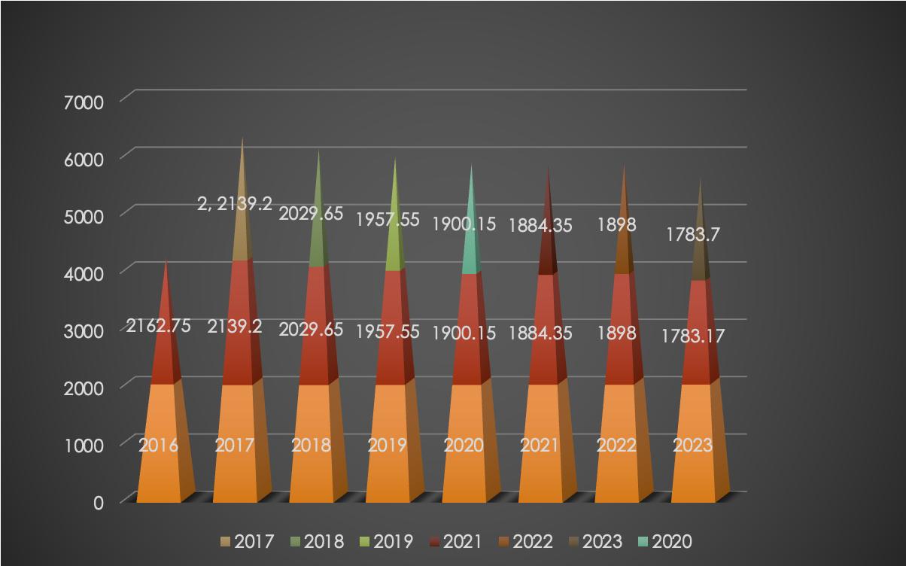
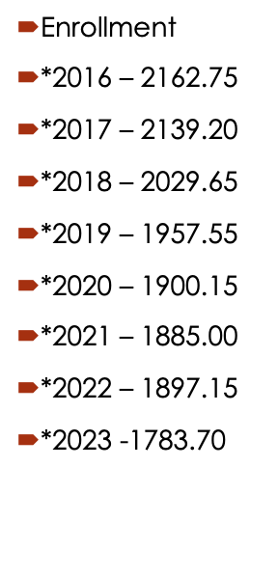
Average Daily Membership (ADM)
Eight-Years Analysis
Notes:
The average daily membership the number of student enrolled in the system on the 20th day after labor day this is how we earn funding for the next fiscal yeear.
465 student average lost 58.13
Next P-1 Summary.

Slide 10
% SALARY CHANGE FROM 2022-2023
YRS EXP | BS | MS | ED | DO | ND
<3 | 4.00% | 4.00% | 4.00% | 4.00% | 4.00%
<6 | 4.00% | 4.00% | 4.00% | 4.00% | 4.00%
<8 | 4.00% | 4.00% | 4.00% | 4.00% | 4.00%
9 | 5.04% | 5.04% | 5.04% | 5.04% | 5.04%
10 | 6.09% | 6.09% | 6.09% | 6.09% | 6.09%
11 | 7.15% | 7.15% | 7.15% | 7.15% | 7.15%
12 | 6.10% | 6.10% | 6.10% | 6.10% | 6.10%
13 | 7.16% | 7.16% | 7.16% | 7.16% | 7.16%
14 | 8.24% | 8.23% | 8.23% | 8.23% | 8.24%
15 | 7.17% | 7.17% | 7.17% | 7.17% | 7.17%
16 | 8.25% | 8.24% | 8.24% | 8.24% | 8.25%
17 | 9.33% | 9.33% | 9.33% | 9.33% | 9.33%
18 | 8.26% | 8.26% | 8.25% | 8.25% | 8.26%
19 | 9.34% | 9.34% | 9.34% | 9.34% | 9.34%
20 | 10.43% | 10.43% | 10.43% | 10.43% | 10.43%

Slide 11
% SALARY CHANGE FROM 2022-2023
YRS EXP | BS | MS | ED | DO | ND
21 | 9.35% | 9.35% | 9.35% | 9.35% | 9.35%
22 | 10.44% | 10.44% | 10.44% | 10.44% | 10.44%
23 | 11.55% | 11.54% | 11.54% | 11.54% | 11.55%
24 | 10.45% | 10.45% | 10.45% | 10.45% | 10.45%
25 | 11.56% | 11.56% | 11.56% | 11.56% | 11.56%
26 | 12.67% | 12.67% | 12.67% | 12.67% | 12.67%
27 | 11.57% | 11.57% | 11.57% | 11.57% | 11.57%
28 | 12.68% | 12.68% | 12.68% | 12.68% | 12.68%
29 | 13.81% | 13.81% | 13.81% | 13.81% | 13.81%
30 | 14.95% | 14.95% | 14.95% | 14.95% | 14.95%
31 | 16.10% | 16.10% | 16.10% | 16.10% | 16.10%
32 | 17.26% | 17.26% | 17.26% | 17.26% | 17.26%
33 | 18.43% | 18.43% | 18.43% | 18.43% | 18.43%
34 | 19.62% | 19.61% | 19.61% | 19.61% | 19.62%
35 | 20.81% | 20.81% | 20.81% | 20.81% | 20.81%

Slide 12
PROJECTED REVENUE
Notes:
Projected Beginning Balance $8,929,690.27
State Revenue $15,543,163.00
Federal Revenue $ 4,470,889.00
Local Revenue $ 7,351,520.36
Other Revenue $ 3,422,435.66. Indirect Cost, Transfer In,

Slide 13
PROJECTED EXPENDITURES
Notes:
Less: Projected Expenditures
Instructional Services (Teachers) 13,785,329.00 39%
Instructional Support (Lib., Coun, Prin, A.P,) 6,600,889.00 18%
Operation & Maintenance 2,545,730.00 7%
Auxiliary Services (CNP & Transportation) 4,216,255.13 12%
Administrative Services (Central Office) 2,655,385.72 7%
Capital Outlay 375,519.65 1%
Debt Services 2,038,972.53 6%
Other Expenditures (indirect Costs ) 8,875,228.00 10%
Total Projected Expenditures 100%

Slide 14
MACON COUNTY SCHOOL SYSTEM
PROPOSED ANNUAL BUDGET
FISCAL YEAR ENDED SEPTEMBER 30, 2023
Equals: Projected Ending Balance (09-30-2023) $ 3,987,768.24
PROJECTED FUND BALANCES (09-30-2023):
General Fund $ 1,789,342.15
Child Nutrition $ 502,508.77
Fleet Renew (School Bus) $ 28,108.38
Local Schools $ 353,614.00
Debt Service $ 1,314,194.94
Notes:
System has one month a operating balance that is required. 1.05 month operating cost.
expenditures 20,563,721.85 /12 1,713,643.49

Slide 15
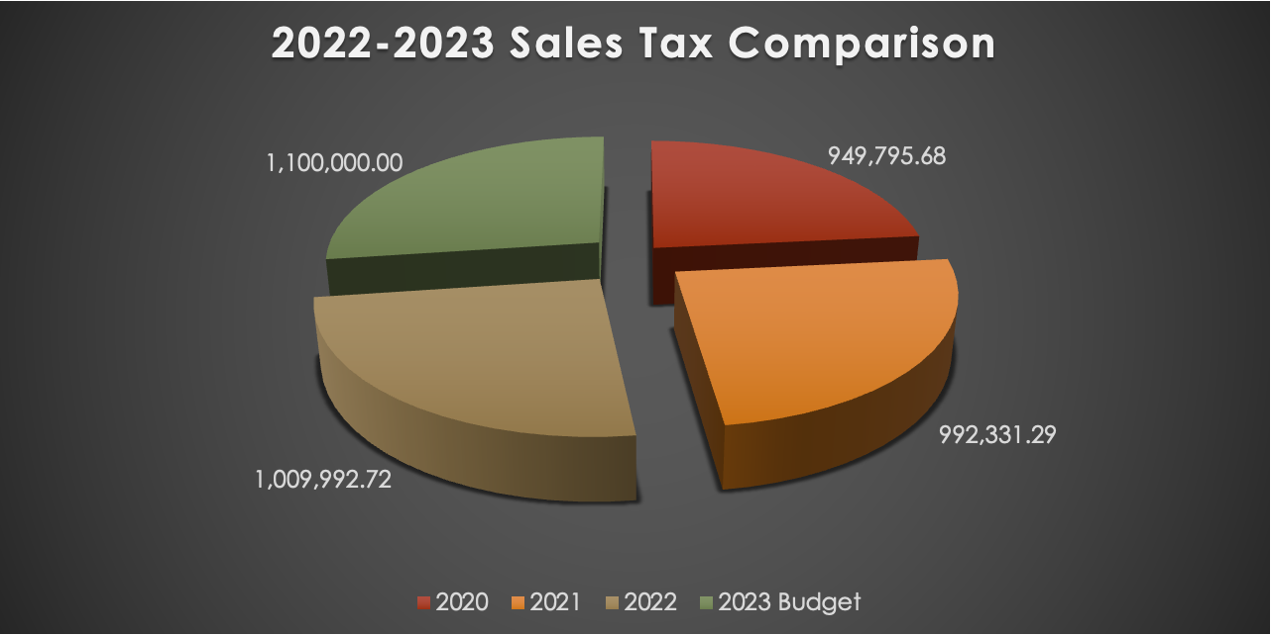
2020-2022 SALES TAX COMPARISON
Notes:
Increase of 17,664.

Slide 16
SUPPLEMENTAL INFORMATION TO PROPOSED FY 2023 BUDGET
As Required by Section 16-13-140,
Code of Alabama 1975
Macon County System Totals
ADM (Prior year used for allocation purposes) | 1,783.70
Earned Units
Teachers | 102.42
Principals | 6.00
Assistant Principals | 2.00
Counselors | 5.00
Librarians | 5.50
Career Tech Director | 2.00
Career Tech Counselors | 1.00
Total Units | 123.92
Notes:
----- Meeting Notes (9/14/15 12:40) -----

Slide 17
SUPPLEMENTAL INFORMATION TO PROPOSED FY 2023 BUDGET
As Required by Section 16-13-140,
Code of Alabama 1975
Macon County System Total Cont’d
Salaries | $7,176,992
Fringe Benefits | $2,729,880
Classroom Instructional Support
Teacher Material and Supplies ($900/unit) | $111,528
Technology ($500/unit) | $61,960
Library Enhancement ($157.72/unit) | $19,545
Professional Development ($100/unit | $12,392
Textbooks ($75/adm) | $133,777
Total Foundation Program | $12,885,149
Less: Local Funds | $1,347,500
Total State Allocation (Foundation Program | $11,537,649
Notes:
----- Meeting Notes (9/14/15 12:40) -----

Slide 18
SUPPLEMENTAL INFORMATION TO PROPOSED FY 2023 BUDGET
As Required by Section 16-13-140,
Code of Alabama 1975
School Nurse - 167,951
At-Risk 68,380
Technology Coordinator - 60,553
ADDITIONAL STATE APPROPRIATIONS

Slide 19
SUPPLEMENTAL INFORMATION TO PROPOSED FY 2023 BUDGET​
As Required by Section 16-13-140,​
Code of Alabama 1975
 | Number by Source of Funds
TYPE | State Earned | OTHER STATE | Federal | Local | Total Employees
Teachers | 102.42 | 5.90 | 37.18 | 1.00 | 146.50
Librarians | 5.50 |  |  |  | 5.50
Counselors | 6.00 |  | 3.00 |  | 9.00
Administrators | 10.00 | 2.84 | 9.16 | 1.00 | 23.00
Certified Supp Personnel |  | 0.36 | 1.64 |  | 2.00
Non. Cert. Supp. Personnel |  | 66.65 | 49.25 | 1.00 | 116.90
Total | 123.92 | 75.75 | 100.23 | 3.00 | 302.90

Slide 20
FY 2022-2023 STATE FUNDS COMPARISON
FOUNDATION PRG | FY 2023 | FY 2022 | CHANGE
SYSTEM ADM | 1,783.70 | 1,897.15 | (113.45)
TEACHERS | 102.42 | 110.42 | (8.00)
PRINCIPALS | 6.00 | 6.00 | 0.00
ASSIS. PRINCIPALS | 2.00 | 2.00 | 0.00
COUNSELORS | 5.00 | 5.00 | 0.00
LIBRARIANS | 5.50 | 5.50 | 0.00
CAREER TECH DIR. | 2.00 | 2.00 | 0.00
CAREER TECH COUN. | 1.00 | 1.00 | 0.00
TOTAL UNITS | 123.92 | 131.92 | (8.00)

Slide 21
FY 2022-2023 STATE FUNDS COMPARISON
STATE FUNDS | FY 2023 | FY 2022 | CHANGE
STUDENT MATERIALS | $111,528 900/unit | $92,344 700/unit | $19,184
TECHNOLOGY | $61,960 500/unit | $65,960 500/unit | ($4,000)
LIBRARY ENHANCEMENT | $19,545 157.72/unit | $20,805 157.72/unit | ($1,260)
PROF. DEVELOPMENT | $12,392 100/unit | $13,192 100/unit | ($800)
TEXTBOOKS | $133,777 75/adm | $142,287 75/adm | ($8,510)
Foundation ETF Program | $11,537,649 | $12,225,268 | ($687,619)
FLEET RENEWAL | $242,592 7,581/ bus | $242,592 7,581/bus | $ 0.00
TRANSPORTATION OPER. | $1,510,486 | $1,456,355 | $54,131

Slide 22
FY 2022-2023 STATE FUNDS COMPARISON
STATE FUNDS | FY 2023 | FY 2022 | CHANGE
School Nurse Program | $ 167,951 | $ 150,142 | $17,809
TECHNOLOGY Coordinator | $ 66,840 | $ 60,967 | $5,873
Capital Purchase | $ 550,978 | $ 572,312 | ($21,334)
At- Risk | $ 68,380 | $ 65,553 | $2,827
Career Tech O & M | $ 35,452 | $ 26,838 | $8,614
Foundation 10 Mills | $1,347,500 | $1,316,660 | $ 30,840
Capital Purchase | $ 71,215 | $ 59,028 | $12,187

Slide 23
FY 2022-2023 FRINGE BENEFITS COMPARISON
FRINGE BENEFITS | FY 2022 | FY 2021 | CHANGE
PEEHIP | $800 | $800 | $0
TRS TIER 1 | 12.59% | 12.43% | .125%
TRS TIER 2 | 11.44% | 11.32% | .01%
AMENDED LEAVE RATE | $100 | $95 | $5.00
PAY RAISE % SUPPORT | .04 | .02 | .02%
PAY RAISE % TRANSPOR. | .04 | .02 | .02%

Slide 24
SUPPLEMENTAL INFORMATION TO PROPOSED FY 2023 BUDGET
As Required by Section 16-13-140,
Code of Alabama 1975
Brighter Path –System Wide 3999-9999
ADM (Prior year used for allocation purposes) | 0
Earned Units
Career Tech Director | 2
Career Tech Counselors | 1
Total Units | 3.00
Salaries | $233,142
Fringe Benefits | $78,799
Classroom Instructional Support
Teacher Material and Supplies ($900/unit) | $2,700
Technology ($500/unit) | $1,500
Library Enhancement ($157.72/unit) | $473
Professional Development ($100/unit | $300
Total Foundation Program | $316,914
Notes:
----- Meeting Notes (9/14/15 12:40) -----

Slide 25
SUPPLEMENTAL INFORMATION TO PROPOSED FY 2022 As Required by Section 16-13-140, Code of Alabama 19 Brighter Path – System Wide 3999-9999
NUMBER BY SOURCE OF FUNDS
Source of Funds
Type | STATE EARNED | OTHER STATE | FEDERAL | LOCAL | TOTAL EMPLOYEES
Teachers |  |  | 2.50 |  | 2.50
Librarians
Counselors | 1.00 |  | .50 |  | 1.50
Administrators | 2.00 | 2.84 | 8.16 | 1.00 | 14.00
Cert Supp Personnel |  | .36 | .64 |  | 1.00
Non Cert Supp Pers |  | 42.65 | 10.75 | 1.00 | 54.40
Total | 3.00 | 45.85 | 22.55 | 2.00 | 73.40

Slide 26
SUPPLEMENTAL INFORMATION TO PROPOSED FY 2023 BUDGET
As Required by Section 16-13-140,
Code of Alabama 1975
BOOKER T WASHINGTON HIGH -0010
9-12
ADM (Prior year used for allocation purposes) 475.65
Earned Units
Teachers 26.50
Principals 1.00
Assistant Principals .50
Counselors 1.00
Librarians 1.00 Total Units 30.00

Slide 27
SUPPLEMENTAL INFORMATION TO PROPOSED FY 2023 BUDGET
As Required by Section 16-13-140,
Code of Alabama 1975
BOOKER T WASHINGTON HIGH-0010
9-12
Salaries $1,782,636
Fringe Benefits $ 673,387
Classroom Instructional Support $ 27,000
Technology $ 15,000
Professional Development $ 3,000
Library Enhancement $ 4,732
Textbooks $ 35,674
Foundation Program $2,541,429

Slide 28
SUPPLEMENTAL INFORMATION TO PROPOSED FY 2023 BUDGET
As Required by Section 16-13-140,
Code of Alabama 1975
BOOKER T WASHINGTON HIGH
9-12
NUMBER BY SOURCE OF FUNDS
 | Source of Funds
Type | STATE EARNED | OTHER STATE | FEDERAL | LOCAL | TOTAL EMPLOYEES
Teachers | 26.50 |  | 9.78 | 1.00 | 37.28
Librarians | 1.00 |  |  |  | 1.00
Counselors | 1.00 |  | 1.50 |  | 2.50
Administrators | 1.50 |  |  |  | 1.50
Cert Supp Personnel |  |  | .25 |  | .25
Non Cert Supp Pers |  | 6.00 | 10.18 |  | 17.18
Total | 30.00 | 6.00 | 21.71 | 1.00 | 58.71

Slide 29
SUPPLEMENTAL INFORMATION TO PROPOSED FY 2023 BUDGET
As Required by Section 16-13-140,
Code of Alabama 1975
D.C. WOLFE SCHOOL –0020 K-6
ADM (Prior year used for allocation purposes) | 117.55
Earned Units
Teachers | 7.14
Principals | 1.00
Counselors | .50
Librarians | .50
Total Units | 9.14
Salaries | $535,173
Fringe Benefits | $201,096
Classroom Instructional Support
Teacher Material and Supplies ($900/unit) | $8,226
Technology ($500/unit) | $4,570
Library Enhancement ($157.72/unit) | $1442
Textbooks ($75/adm) | $8,816
Total Foundation Program | $760,237
Notes:
----- Meeting Notes (9/14/15 12:40) -----

Slide 30
SUPPLEMENTAL INFORMATION TO PROPOSED FY 2023 BUDGET
As Required by Section 16-13-140,
Code of Alabama 19 DC WOLFE SCHOOL - 0020
K-6
NUMBER BY SOURCE OF FUNDS
Source of Funds
Type | STATE EARNED | OTHER STATE | FEDERAL | LOCAL | TOTAL EMPLOYEES
Teachers | 7.14 | 1.00 | 4.00 |  | 12.14
Librarians | .50 |  |  |  | .50
Counselors | .50 |  |  |  | .50
Administrators | 1.00 |  | . |  | 1.00
Cert Supp Personnel |  |  | .08 |  | .08
Non Cert Supp Pers |  | 3.00 | 3.11 |  | 6.11
Total | 9.14 | 4.00 | 7.19 |  | 20.33

Slide 31
SUPPLEMENTAL INFORMATION TO PROPOSED FY 2023 BUDGET
As Required by Section 16-13-140,
Code of Alabama 1975
GEORGE WASHINGTON CARVER -0025
K-3
ADM (Prior year used for allocation purposes) 359.15
Earned Units
Teachers 28.32
Principals 1.00
Assistant Principals 0.00
Counselors .50
Librarians 1.00
Total Units 30.82

Slide 32
SUPPLEMENTAL INFORMATION TO PROPOSED FY 2023 BUDGET
As Required by Section 16-13-140,
Code of Alabama 1975
GWC SCHOOL-0025
K-3
Salaries $1,610,125
Fringe Benefits $ 610,813
Classroom Instructional Support $ 24,921
Technology $ 13,845
Professional Development $ 2,769
Library Enhancement $ 4,367
Textbooks $ 26,936
Total Foundation Program $ 2,293,776

Slide 33
SUPPLEMENTAL INFORMATION TO PROPOSED FY 2023 BUDGET
As Required by Section 16-13-140,
Code of Alabama 1975
GWC
K-3
NUMBER BY SOURCE OF FUNDS
***Level of Degree | Source of Funds
Type | STATE EARNED | OTHER State | FEDERAL | LOCAL | TOTAL EMPLOYEES
Teachers | 25.19 | 2.90 | 5.00 |  | 33.09
Librarians | 1.00 |  |  |  | 1.00
Counselors | .50 |  |  |  | .50
Administrators | 1.00 |  | 1.00 |  | 2.00
Cert Supp Personnel |  |  | .24 |  | .24
Non Cert Supp Pers |  | 4.00 | 5.21 |  | 9.21
Total | 27.69 | 6.90 | 11.45 |  | 46.04
Local School Funds Budgeted: Public - $23,028 ; Non-Public - $11,000= $34,028

Slide 34
SUPPLEMENTAL INFORMATION TO PROPOSED FY 2023 BUDGET
As Required by Section 16-13-140,
Code of Alabama 1975
NOTASULGA HIGH SCHOOL -0060
K-12
ADM (Prior year used for allocation purposes) 282
Earned Units
Teachers 16.25
Principals 1.00
Assistant Principals 0.50
Counselors 1.00
Librarians 1.00 Total Units 19.25

Slide 35
SUPPLEMENTAL INFORMATION TO PROPOSED FY 2023 BUDGET
As Required by Section 16-13-140,
Code of Alabama 1975
NOTASULGA HIGH SCHOOL-0060
K-12
Salaries $ 1,102,128
Fringe Benefits $ 425,569
Classroom Instructional Support $ 17,775
Technology $ 9,875
Library $ 3,115
Professional Development $ 1,975
Textbooks $ 21,150
Total Foundation $ 1,581,587

Slide 36
SUPPLEMENTAL INFORMATION TO PROPOSED FY 2023 BUDGET
As Required by Section 16-13-140,
Code of Alabama 1975
NOTASULGA HIGH SCHOOL
NUMBER BY SOURCE OF FUNDS
 | Source of Funds
Type | STATE EARNED | OTHER STATE | FEDERAL | LOCAL | TOTAL EMPLOYEES
Teachers | 16.25 | 2.00 | 8.73 |  | 26.98
Librarians | 1.00 |  |  |  | 1.00
Counselors | 1.00 |  | 1.00 |  | 2.00
Administrators | 1.50 |  |  |  | 1.50
Cert Supp Personnel |  |  | .14 |  | .14
Non Cert Supp Pers |  | 6.00 | 5.64 |  | 11.64
Total | 19.75 | 8.00 | 15.51 |  | 43.26
Local School Funds Budgeted: Public - $44,007 ; Non-Public - $23,971 = $67,978

Slide 37
SUPPLEMENTAL INFORMATION TO PROPOSED FY 2023 BUDGET
As Required by Section 16-13-140,
Code of Alabama 1975
TUSKEGEE PUBLIC SCHOOL-0095
4-6
ADM (Prior year used for allocation purpose) 293.3
Earned Units
Teachers 14.35
Principals 1.00
Assistant Principals 0.50
Counselors 1.00
Librarians 1.00
Total Units 17.85

Slide 38
SUPPLEMENTAL INFORMATION TO PROPOSED FY 2023 BUDGET
As Required by Section 16-13-140,
Code of Alabama 1975
TUSKEGEE PUBLIC SCHOOL-0095
4-6
Salaries $ 1,012,845
Fringe Benefits $ 386,466
Classroom Instructional Support $ 16,065
Technology $ 8,925
Library Enhancement $ 2,815
Professional Development $ 1,785
Textbooks $ 21,997

Slide 39
SUPPLEMENTAL INFORMATION TO PROPOSED FY 2023 BUDGET
As Required by Section 16-13-140,
Code of Alabama 1975
TUSKEGEE PUBLIC SCHOOL
NUMBER BY SOURCE OF FUNDS
 | Source of Funds
Type | STATE EARNED | OTHER STATE | FEDERAL | LOCAL | TOTAL EMPLOYEES
Teachers | 14.35 |  | 5.77 |  | 20.12
Librarians | 1.00 |  |  |  | 1.00
Counselors | 1.00 |  |  |  | 1.00
Administrators | 1.50 |  |  |  | 1.50
Cert Supp Personnel |  |  | .16 |  | .16
Non Cert Supp Pers |  | 3.00 | 5.14 |  | 8.14
Total | 17.85 | 3.00 | 11.07 |  | 31.92
Local School Funds Budgeted: Public - $8,732 Non-Public $6,209 = $14,941

Slide 40
SUPPLEMENTAL INFORMATION TO PROPOSED FY 2022 BUDGET
As Required by Section 16-13-140,
Code of Alabama 1975
TUSKEGEE INSTITUTE MIDDLE SCHOOL-0100
7-8
ADM (Prior year used for allocation purposes) 256.05
Earned Units
Teachers 12.99
Principals 1.00
Assistant Principals 0.50
Counselors 1.00
Librarians 1.00 Total Units 16.49

Slide 41
SUPPLEMENTAL INFORMATION TO PROPOSED FY 2023 BUDGET
As Required by Section 16-13-140,
Code of Alabama 1975
TUSKEGEE INSTITUTE MIDDLE SCHOOL-0100
6-8
Salaries $ 900,943
Fringe Benefits $ 352,361
Classroom Instructional Support $ 14,841
Technology $ 8,245
Library Enhancement $ 2,601
Professional Development $ 1,649
Textbooks $ 19,204
Total Foundation Program $ 1,299,844

Slide 42
SUPPLEMENTAL INFORMATION TO PROPOSED FY 2023 BUDGET
As Required by Section 16-13-140,
Code of Alabama 1975
TUSKEGEE INSTITUTE MIDDLE SCHOOL-0100
NUMBER BY SOURCE OF FUNDS
***Level of Degree | Source of Funds
Type | STATE EARNED | OTHER State | FEDERAL | LOCAL | TOTAL EMPLOYEES
Teachers | 12.99 |  | 1.40 |  | 14.39
Librarians | 1.00 |  |  |  | 1.00
Counselors | 1.00 |  |  |  | 1.00
Administrators | 1.50 |  |  |  | 1.50
Cert Supp Personnel |  |  | .13 |  | .13
Non Cert Supp Pers |  | 2.00 | 9.22 |  | 11.22
Total | 16.49 | 2.00 | 10.75 |  | 29.24
Local School Funds Budgeted: Public - $59,826 Non-Public - $27,236 = $ 87,062

